Slide 1

Word Senses and WordNet

Slide 2
Contents
Introduction
Motivation for Word Senses
WordNet Structure
WordNet Relations
Word Sense Disambiguation (WSD)
Word Sense Expansion and WordNet Enhancement

Slide 3
Introduction
Understanding Word Meanings in Context
  Word Senses
    Word senses refer to the various meanings that a single word can have based on its surrounding context.
    Contextual cues help disambiguate which specific meaning of a word is intended in a given instance.
    For example, the word "bank" can mean a financial institution or the edge of a river, and the intended sense depends on the sentence's context.
  WordNet
    WordNet is a comprehensive lexical database that organizes words into synsets (synonym sets), which are groups of words sharing a common meaning or sense.
    WordNet captures the relationships between words and their meanings, enabling a deeper understanding of how words are related to each other.
    Synsets in WordNet help disambiguate word senses by grouping words that are interchangeable in specific contexts.

Slide 4
Motivation for Word Senses
Importance of Understanding Word Senses in NLP
  Resolving Ambiguity in Text
    Ambiguity arises when a word has multiple meanings. Accurately determining the intended sense of a word in a given context is essential for accurate language understanding. NLP models that can disambiguate word senses improve the precision of downstream tasks such as machine translation, text summarization, and sentiment analysis.
  Improving Machine Understanding
    NLP models aim to simulate human language understanding. Recognizing word senses helps these models grasp the nuances and subtleties of language, enabling them to interpret text in a manner closer to human comprehension. This is particularly crucial for tasks involving humor, metaphor, or cultural references.
  Enhancing Human-Computer Interaction
    In human-computer interaction, systems need to understand user inputs accurately to provide relevant and contextually appropriate responses. By correctly identifying word senses, chatbots, virtual assistants, and search engines can generate more relevant and helpful responses, leading to better user experiences.
  Boosting Information Retrieval
    Retrieving relevant information from a large corpus relies on the accurate interpretation of query terms. Understanding word senses enhances the precision of information retrieval systems by ensuring that retrieved documents match the intended meaning of the query.

Slide 5
Motivation for Word Senses
Importance of Understanding Word Senses in NLP
  Enabling Advanced NLP Tasks
    Advanced NLP tasks like sentiment analysis require a deep understanding of word senses to accurately interpret emotions and attitudes expressed in text. For example, distinguishing between positive and negative uses of words like "sick" or "cool" is essential for sentiment analysis.
  Enhancing Language Generation
    When generating text, machines need to choose words with the appropriate sense to ensure the conveyed message is coherent and accurate. This applies to tasks like text generation, automatic summarization, and machine translation.
  Supporting Cross-Domain Applications
    Understanding word senses facilitates knowledge transfer across different domains. NLP models trained to recognize word senses in one domain can adapt their understanding to new domains, enabling broader applicability.
  Facilitating Multilingual NLP
    Different languages often have distinct senses for the same word. Accurate word sense disambiguation is essential for multilingual NLP tasks to ensure accurate translation and cross-lingual information retrieval.

Slide 6
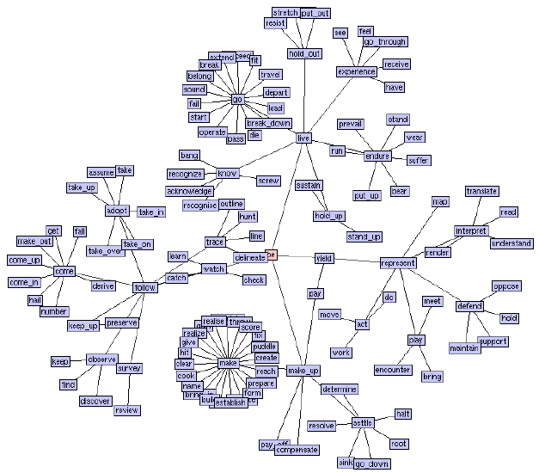
WordNet Structure
Organizing Word Senses
  WordNet is organized into a structured hierarchy that captures the relationships between words and their meanings.
  This hierarchical structure helps represent word senses, synonyms, and their relationships.
  Here's an overview of its key components:

Slide 7
WordNet Structure
Organizing Word Senses
  Synsets (Synonym Sets)
    Synsets are groups of synonymous words that share a common meaning or sense.
    Each synset represents a specific word sense, making it easier to disambiguate word meanings in various contexts.
    For example, the word "bank" could have separate synsets for its financial institution and riverbank meanings.
  Hyponymy/Hypernymy Relationships
    Hyponymy and hypernymy relationships create a hierarchical structure within WordNet.
    A hyponym is a more specific word that is a subset of a more general word (hypernym).
    For instance, "rose" is a hyponym of "flower," where "rose" is a specific type of "flower."
    This hierarchy allows users to navigate from broader concepts to more specific ones and vice versa.

Slide 8
WordNet Structure
Organizing Word Senses
  Meronymy Relationships
    Meronymy relationships indicate part-whole relationships. A meronym is a part or component of a larger whole, while a holonym is the whole entity containing the part.
    For instance, "wheel" is a meronym of "car.“
  Antonymy Relationships
    WordNet also includes antonymy relationships, capturing opposite meanings between words. Antonyms provide further context for understanding word senses.
  Example Sentences
    Many synsets are associated with example sentences, demonstrating how a word is used in context.
    These examples aid in understanding word usage and meaning.
  Verb Frames
    For verbs, WordNet includes information about the syntactic frames they can appear in. This helps capture the different ways a verb can be used in sentences.

Slide 9
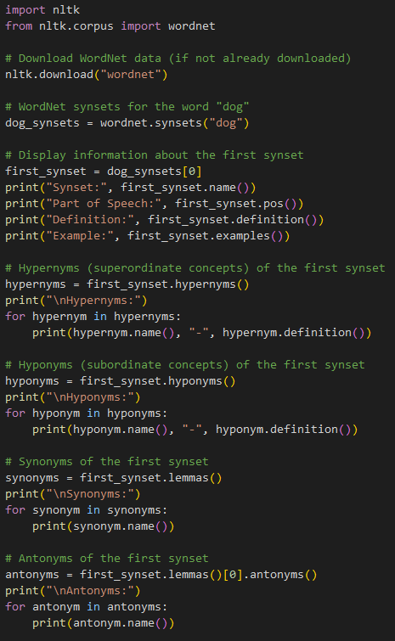
WordNet Structure
Python Implementation
In this example:
We use the nltk library to interact with the WordNet lexical database.
We download the WordNet data using nltk.download("wordnet").
We retrieve synsets (sets of synonymous words) for the word "dog."
We display information about the first synset, including its name, part of speech, definition, and examples.
We explore hypernyms (superordinate concepts) and hyponyms (subordinate concepts) of the first synset.
We list synonyms and antonyms for the first synset using the lemmas() method.
This example showcases how to access and explore WordNet's hierarchical structure and lexical relationships using the nltk library.

Slide 10
WordNet Relations
Different Types of Relations in WordNet
  Hypernymy and Hyponymy
    Hypernymy: A hypernym is a more general word that represents a broader category. For example, "animal" is a hypernym of "dog."
    Hyponymy: A hyponym is a more specific word that falls within a broader category. For example, "cat" is a hyponym of "animal."
  Meronymy and Holonymy
    Meronymy: Meronyms represent part-whole relationships. For instance, "wheel" is a meronym of "car."
    Holonymy: Holonyms indicate the whole entity that contains the part. For example, "car" is a holonym of "wheel."
  Antonymy
    Antonyms are words with opposite meanings. For instance, "happy" and "sad" are antonyms.

Slide 11
WordNet Relations
Different Types of Relations in WordNet
  Entailment
    Entailment relations indicate that the truth of one statement implies the truth of another. For example, if "John sleeps," then it entails that "John is not awake."
  Similarity (Similar to)
    Similarity relations capture the similarity in meanings between words, even if they are not synonyms. For instance, "wet" and "damp" are similar words.
  Cause (Cause of)
    Cause relations indicate a cause-and-effect relationship between words. For example, "rain" is the cause of "wetness."

Slide 12
WordNet Relations
Different Types of Relations in WordNet
  Attribute (Has attribute)
    Attribute relations connect nouns with their attributes. For instance, "beauty" is an attribute of "flower."
  Domain Terms
    Domain terms represent words associated with specific fields or domains. For example, "equation" is a domain term related to mathematics.
  Verb Group
    Verb group relations connect verbs that share similar syntactic patterns. For example, "sleep" and "rest" are part of the same verb group.

Slide 13
Word Sense Disambiguation (WSD)
Word Sense Disambiguation (WSD) is a fundamental natural language processing task that aims to determine the correct meaning (sense) of a word within a particular context.
Since many words have multiple senses, understanding the intended sense is essential for accurate language understanding and interpretation.

Slide 14
Word Sense Disambiguation (WSD)
Challenges in WSD
  Contextual Ambiguity
    Words can have different meanings based on the surrounding words and the overall sentence context.
    The same word can take on various senses depending on how it's used in a sentence.
  Polysemy
    Many words exhibit polysemy, meaning they have multiple related senses. For instance, "bank" can refer to a financial institution or a riverbank.
    Identifying the correct sense requires considering the context in which the word appears.
  Word Overlap
    Sometimes, the same word or related words appear in different parts of a text, leading to the potential for confusion regarding the intended sense.
    Resolving this requires analyzing the overall structure and meaning of the text.
  Limited Context
    In some cases, the immediate context might not provide enough information to disambiguate word senses.
    Additional information from the broader text or external knowledge sources may be needed.

Slide 15
Word Sense Disambiguation (WSD)
Challenges in WSD
  Ambiguity in WordNet
    Even in resources like WordNet, where senses are organized, there can be ambiguity in categorizing senses, leading to challenges in accurately mapping context to the correct sense.
  Domain-Specific Ambiguity
    Certain words may have different senses depending on the domain or specialized field. Recognizing domain-specific senses requires domain knowledge.
  Word Order and Structure
    Word order and sentence structure can influence the intended sense of a word.
    Complex sentences may require considering the role of the word in the overall structure.
  Word Usage Evolution
    Over time, the meaning of words can shift, leading to different senses becoming more or less common.
    Historical context might be necessary to disambiguate such cases.

Slide 16
Word Sense Expansion and WordNet Enhancement
Word Sense Expansion
  Word sense expansion refers to the process of automatically enriching the synsets in resources like WordNet with additional related words and their meanings.
  This expansion aims to improve the coverage and accuracy of word senses, making them more reflective of the diversity of language usage in various contexts.

Slide 17
Word Sense Expansion and WordNet Enhancement
Key Points
  Synset Enrichment
    WordNet organizes words into synsets, each representing a specific sense.
    These synsets often include synonyms and related words, but they might not cover all the nuances and variations in word usage.
  Automatic Extraction
    To expand word senses, researchers and developers employ computational techniques that analyze large text corpora.
    By identifying words that co-occur frequently with synset members, the system can infer potential additional senses.
  Related Words
    Expansion involves identifying words that are semantically related to existing synset members.
    These related words may have slightly different meanings or connotations, contributing to a more comprehensive representation of a word's senses.
  Disambiguation Challenges
    While word sense expansion can improve coverage, it also introduces the challenge of disambiguation.
    Some related words might be contextually restricted or have distinct nuances, requiring careful consideration to determine their relevance to a specific sense.

Slide 18
Word Sense Expansion and WordNet Enhancement
Enhancing WordNet and Beyond
  Multilingual WordNets
    Efforts have been made to expand WordNet to cover more languages, allowing a broader range of languages to benefit from structured word sense information.
    These multilingual WordNets help facilitate cross-lingual information retrieval, machine translation, and more.
  Domain-Specific Vocabularies
    WordNet has been extended to include domain-specific vocabularies.
    For instance, domain-specific WordNets cater to fields like law, medicine, and biology.
    These extensions ensure that the vocabulary and word senses are tailored to specific domains.
  Linked Data and Ontologies
    In addition to traditional lexical resources like WordNet, linked data and ontologies play a role in representing word senses.
    Efforts like the Linked Open Data cloud enable connections between different knowledge bases, enriching the semantic web with structured information.

Slide 19
Practice
Instructions
  In this assignment, you'll explore word senses and the WordNet lexical database using the nltk library.
Tasks
  Task 1: Exploring WordNet Word Senses
    Choose a polysemous word (a word with multiple meanings, e.g., "bank," "bat," "lead").
    Retrieve and list all synsets (word senses) for the chosen word.
    For each synset, display its definition and examples.
  Task 2: Hypernyms and Hyponyms
    Choose a specific synset from the previous task.
    Display hypernyms (superordinate concepts) and hyponyms (subordinate concepts) of the chosen synset.
  Task 3: Synonyms and Antonyms
    Choose a specific synset from the previous task.
    List synonyms and antonyms for the chosen synset.

Slide 20
Q & A

